Slide 1
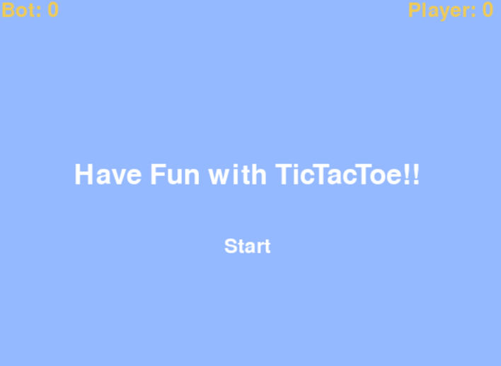
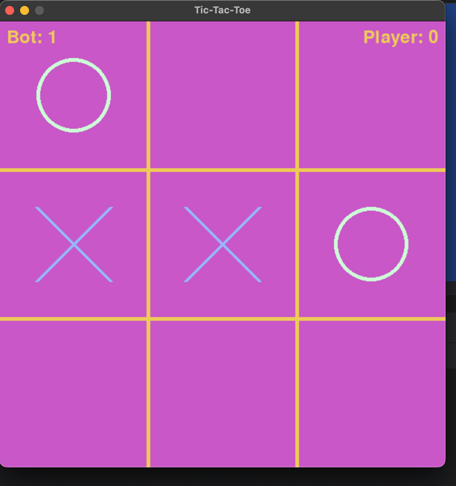
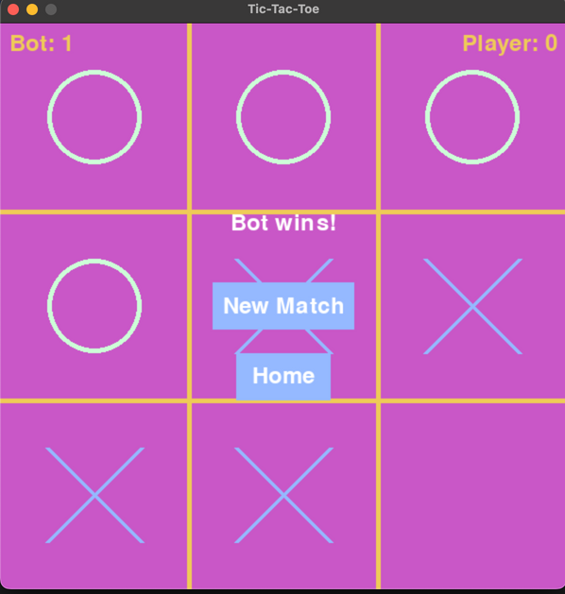
Team Project
TicTacToe AI_Game:
Welcome to my Project Ladies and Gentlemen
My project is a a TicTacToe Game which we used to play it in our childhood .
Sometimes We want to Play this Game but we unfortunately don’t find a Partner to play with us!.
For this reason it comes the idea to develop this Game .
So that we develop a game which allow us to play with a Bot .
Here is an OverView :
Let’s press Start and play a bit
After Playing abit
and finishing the match

Slide 2

Game Objectives:
Develop An engaging and user-friendly TicTacToe Game using PyGame package , so that the user can play the game comfortably and having fun with it .
Implement a challenging computer opponent using the minimax algorithm , which help the Bot to perform the best move considering the outcomes of each move.
Providing a seamless gaming experience with clear user interface elements.
Foster a sense of nostalgia by combining a classic game with modern technology

Slide 3

Project Description
Our project focuses on creating an interactive Tic-Tac-Toe game using Pygame. Players can enjoy a classic game against a computer opponent that utilizes the minimax algorithm for intelligent moves.
he intuitive user interface ensures a seamless gaming experience, while the incorporation of Pygame allows for engaging visuals and interactions. This project not only delivers a game but aims to evoke a sense of nostalgia while embracing modern game development principles

Slide 4

Game
Functionalities :
Player Vs Computer Gameplay.
Smart computer moves powered by MiniMax Algorithm
Start, New Match, and Home Buttons for intuitive navigation.
Score tracking to keep a record of player and computer Victories
Visual representation of the Game board for an immersive experience

Slide 5

Todo lIST:
Graphical Interface:
Implement a visually appealing and user-friendly game interface.
Design clear and intuitive buttons for Start, New Match, and Home actions.
Ensure visual consistency throughout the game for a polished look
2. Minimax Algorithm:
Fine-tune the minimax algorithm to provide challenging and intelligent computer moves.
Conduct extensive testing to identify and address any potential edge cases.
Optimize the algorithm for smooth and efficient gameplay.
3. Visual Feedback:
Enhance user experience by incorporating visual feedback for different game outcomes.
Implement animations or effects to highlight significant events, such as a winning move or a tie game.
Ensure that visual elements contribute to a dynamic and engaging gaming environment.

Slide 6

Not-To-do lIST:
Multiplayer Functionality:
While multiplayer functionality would be interesting, it falls outside the scope of the current project
The focus is on creating a compelling single-player experience against an intelligent computer opponent.
2. Advanced Graphics and Animations :
While visually appealing elements are essential, the project won't include advanced graphics or extensive animations.
This decision is made to maintain a balance between aesthetics and project scope.
3. Feature Creep :
Avoid unnecessary additions that may lead to feature creep
Stick to the defined objectives and functionalities to ensure a focused and achievable project

Slide 7
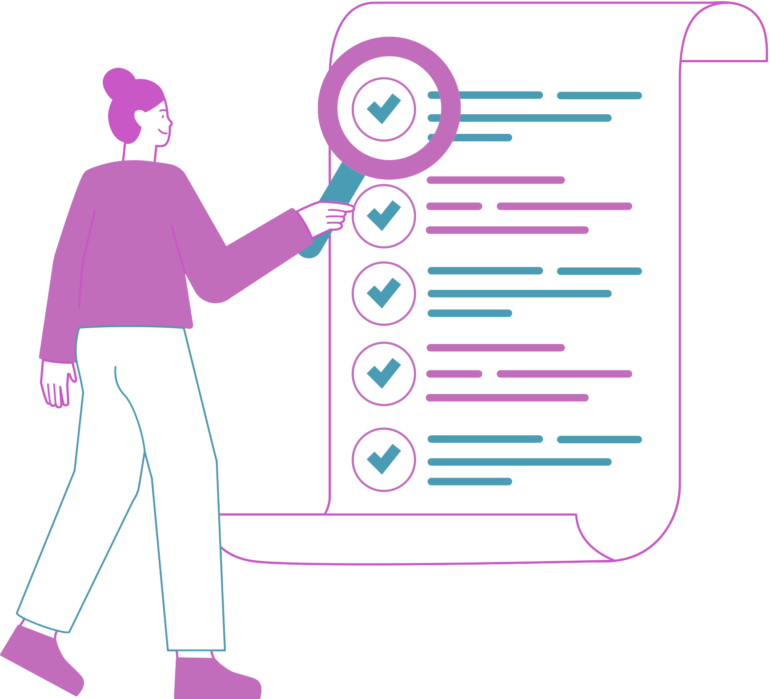
MSCW Priorities :
Must Have :
Player vs. Computer gameplay for the core functionality.
Score tracking to monitor player and computer victories.
2. Should Have:
Intelligent computer move using the minimax algorithm for a challenging opponent.
User-friendly interface with Start, New Match, and Home buttons.
3. Could Have:
Enhanced graphical interface for an improved visual experience.
4. Won’t Have:
Enhanced graphical interface for an improved visual experience.

Slide 8

tIMELINE :
Design and Planning: Weeks 1-2
Define project requirements and outline game design.
Create wireframes and design the game's visual elements.
Create wireframes and design the game's visual elements.
2. Implementation: Weeks 3-6
Develop the core gameplay mechanics, including player moves and basic game flow
Implement the minimax algorithm for intelligent computer moves.
Integrate graphical elements and ensure a cohesive user interface.
3. Testing and Debugging: Weeks 7-8 :
Conduct thorough testing to identify and resolve bugs or issues.
Gather feedback from playtesting to enhance user experience.
Optimize performance and address any remaining glitches.
4. Finalization and Documentation: Weeks 9-10 :
Refine the game's visuals and implement any additional features.
Document the codebase, providing clear comments for future reference.
Prepare user documentation and finalize the project for delivery.

Slide 9
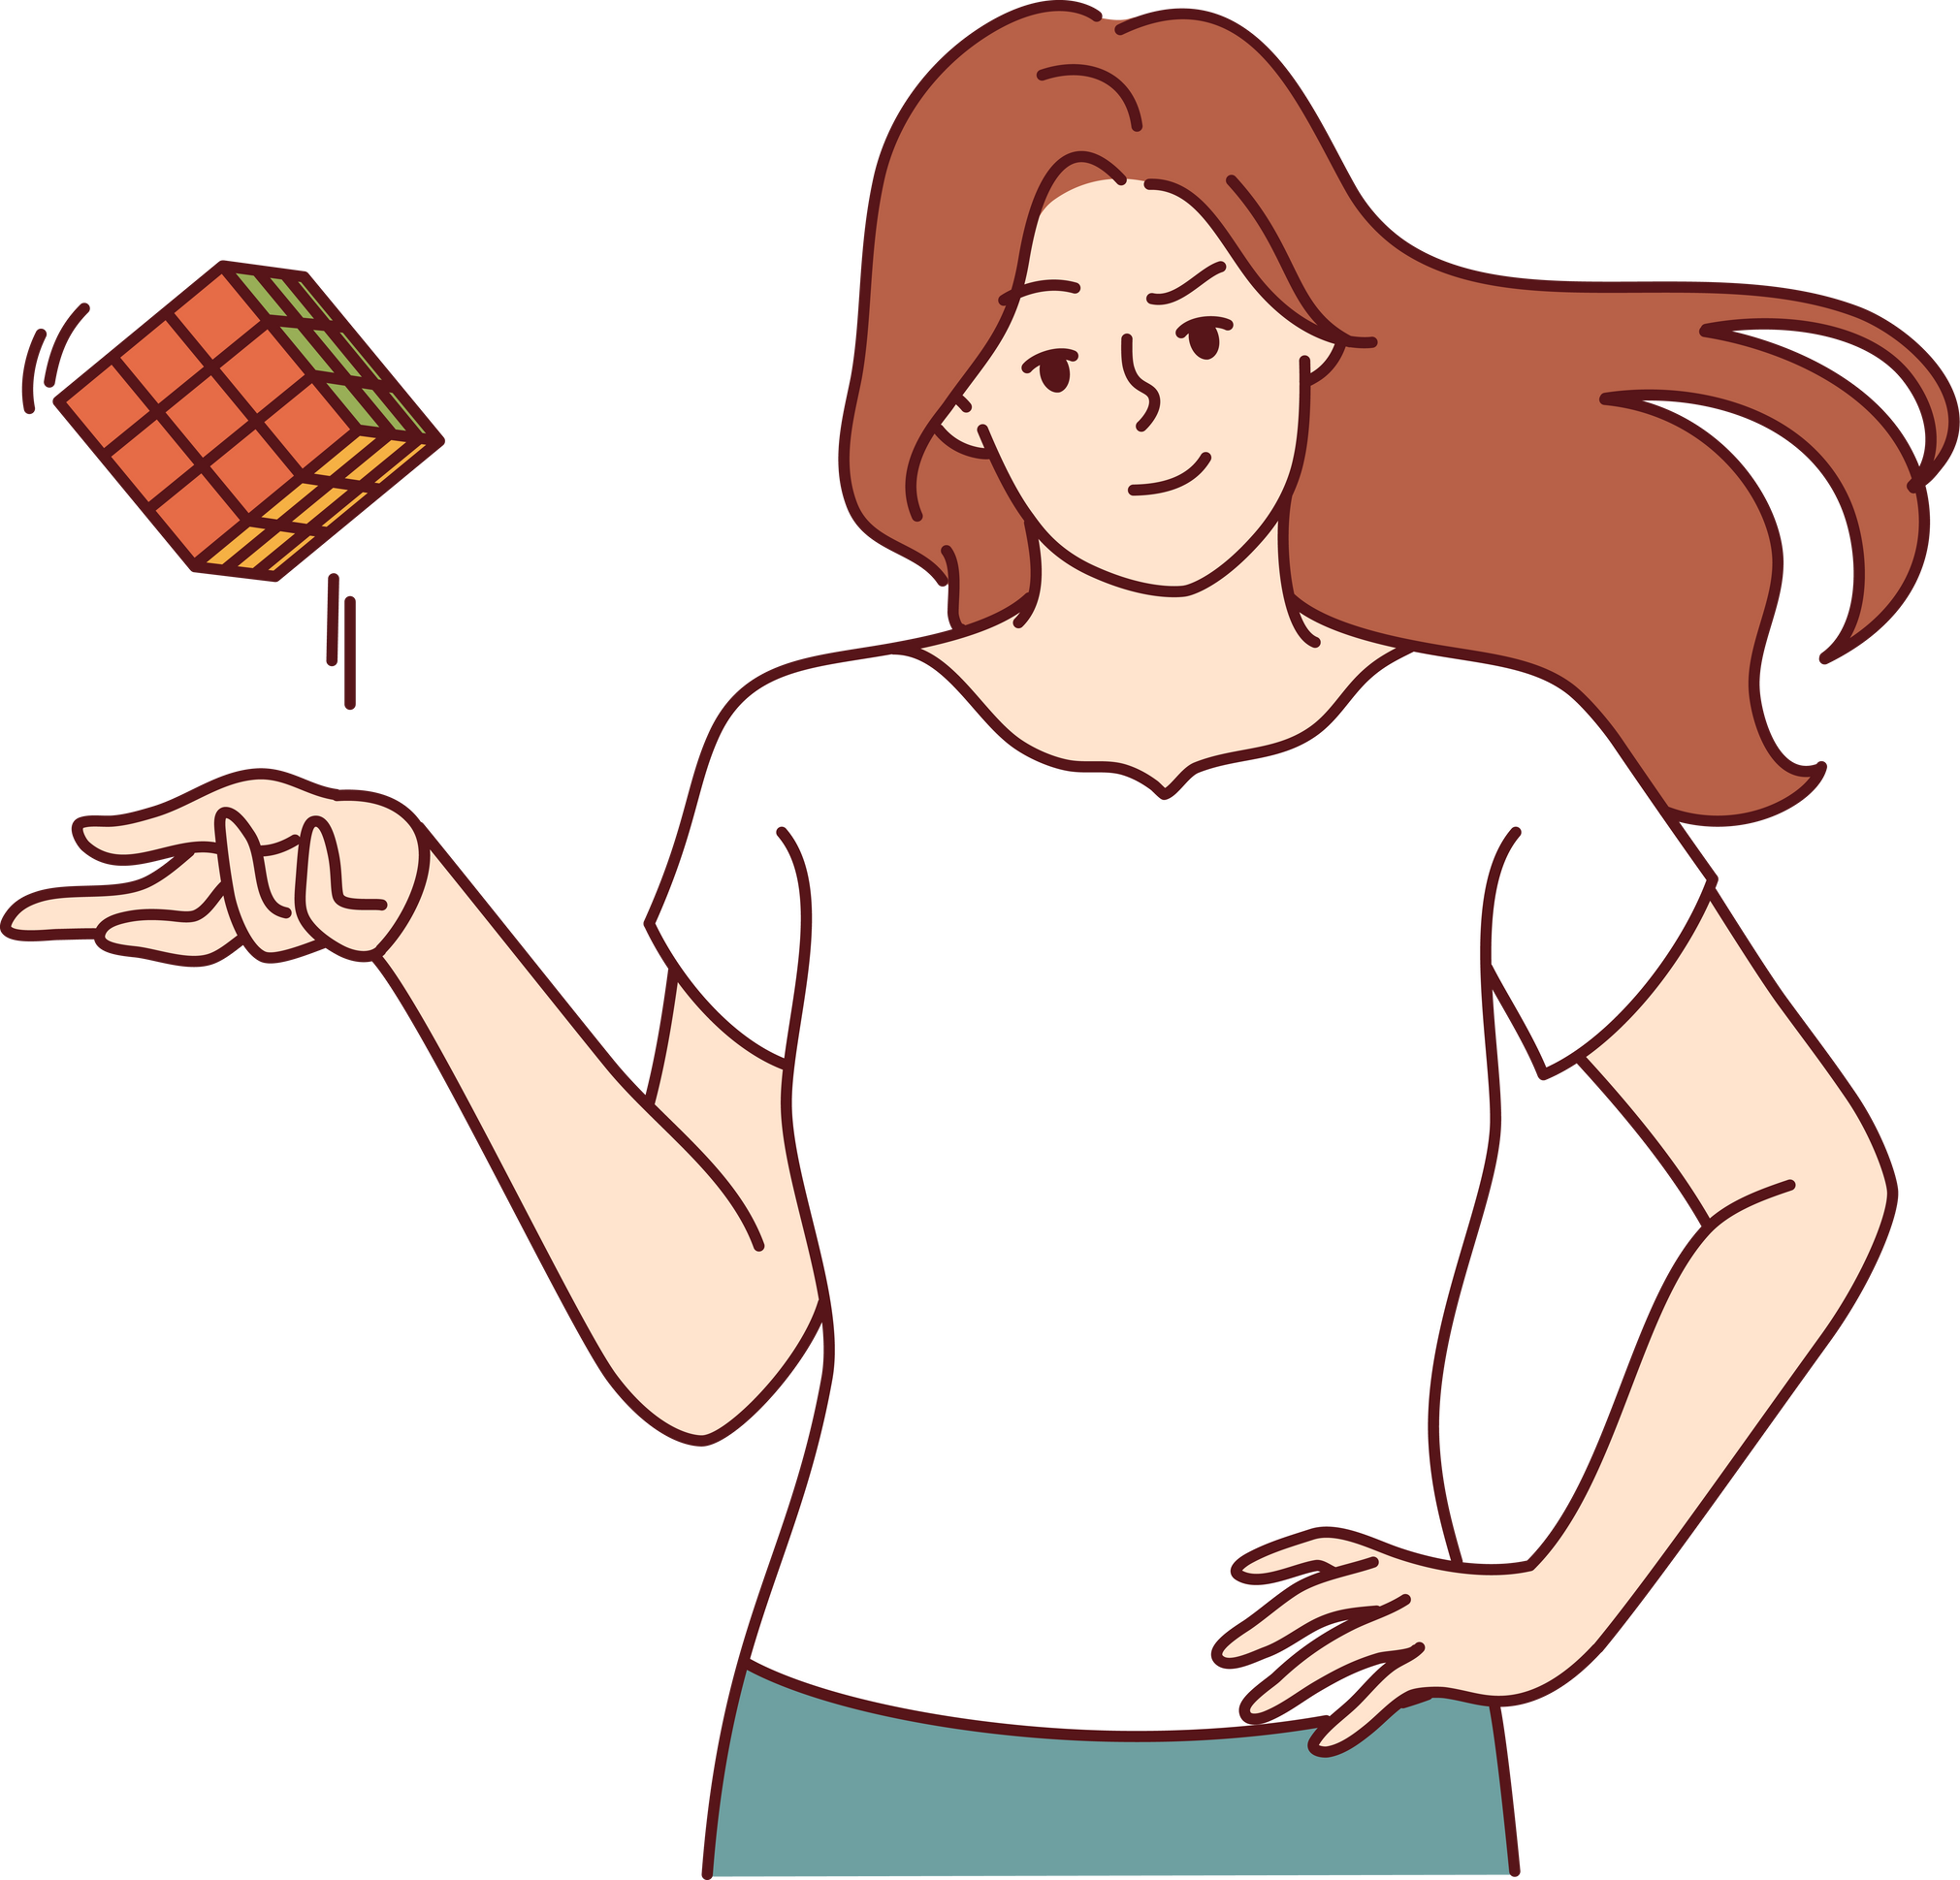
Challenges :
MiniMax Algorithm Debugging:
Honestly By developping the game I found many issues and challenges especially With MiniMax as it is a decision Making Tree
Debugging MiniMax Algorithm was one of the hardest parts as we should provide a very logical game so to do that you may need to understand the way that MiniMax uses to look for shortest path to make the correct decision and make a valid moves ,
2. Graphic Design for User Interface:
Graphics were also a bit complicated , as we should create UI-buttons, labels, and suitable colors to make the game User-Friendly
3. User Experience Optimisation :
Ensuring seamless and engaging experience involves optimizing visual feedback and animations
Stricking a balance between informative and non-intrusive visual elements require iterative design and testings

Slide 10
Conclusion:
Project Achievement:
The successful development of a fully functional Tic-Tac-Toe game with an intelligent computer opponent marks a significant Project Milestone.
2. Adherence to Objectives :
The project aligns with its initial objectives, delivering a classic game with a modern twist and providing enjoyable gaming experience.
3. Future Enhancements :
While the project Achieves its Core goals, there’s potential for future enhancements, Additional features , improved graphics, or multiplayer functionality could be explored in subsequent iterations.
3. Future Enhancements :

Slide 11

Ressources That help to build the Game:
Pygame Official Documentation
A comprehensive guide to the Pygame library, covering everything from installation to advanced features
2. GeeksForGeeks.com
I would lovely recommend it if you want to learn concepts AI algorithms such as Genetic Algorithm, Best First search, Minimax .... .
3. LinkedIn Learning :
If you can buy a membership and open account you will discover amany courses that can speed up and improve your career and skills , I also recommend it if you wanna advanced stuff about AI and how you can use those Algorithms for Implementation of your code... .

